Slide 1
Annihilating Workloads with Azure Functions
Kevin Griffin

Slide 2
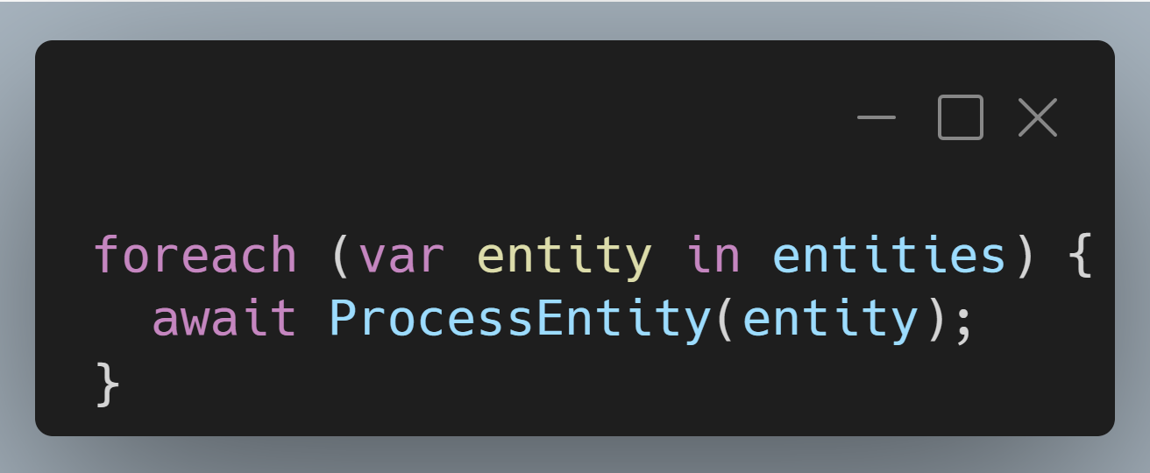
Entity 0 000 000
Entity 0 000 001
Entity 0 000 002
Entity 2 000 000

Slide 3
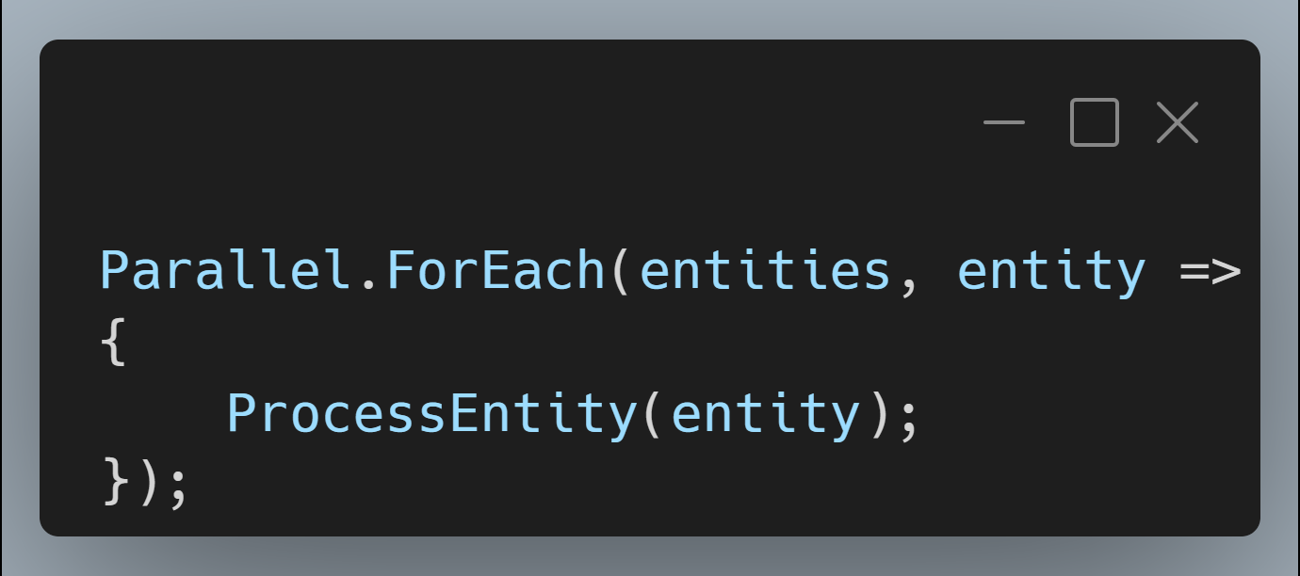
Entity 0 000 000
Entity 0 000 001
Entity 0 000 002
Entity 2 000 000

Slide 4
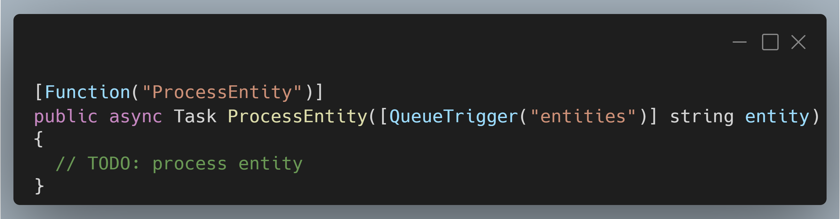
Entity 0 000 000
Entity 0 000 001
Entity 0 000 002
Entity 2 000 000

Slide 5
Entity 0 000 000
Entity 0 000 001
Entity 0 000 002
Entity 2 000 000

Slide 6

Hi, I’m Kevin

Slide 7
Kevin Griffin 14-time Microsoft MVP ASP.NET Core, Azure, and Web consultwithgriff.com twitter.com/@1kevgriff linkedin.com/in/1kevgriff bbiz.io/@1kevgriff

Slide 8

Host of Multithreaded Income Podcast Listen @ podcast.multithreadedincome.com Discord @ http://mti.to/discord

Slide 9
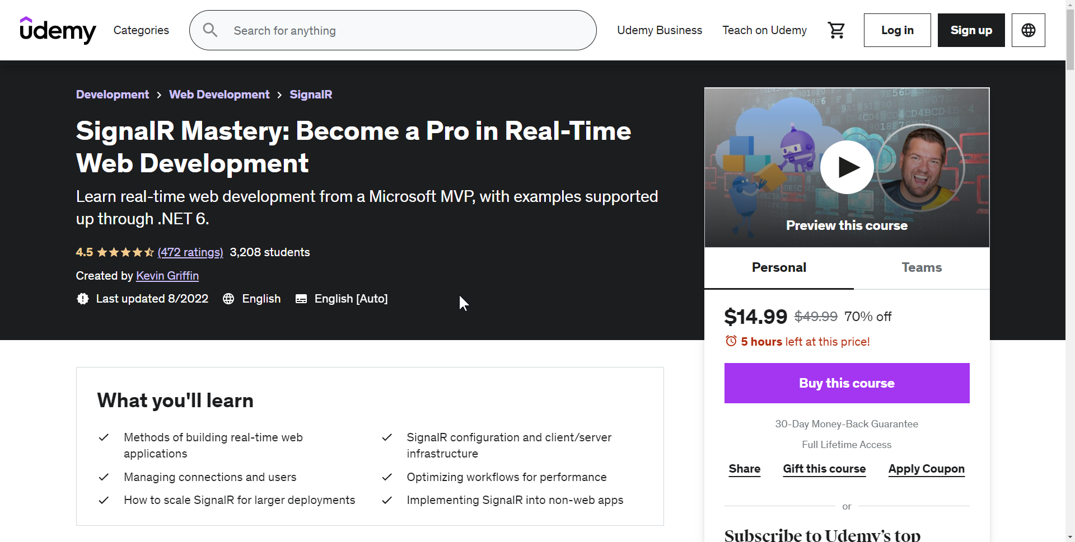
Courses
https://SignalRMastery.com

Slide 10

Agenda
The “Promise of Serverless”
100-level Intro of Azure Functions
Designing Workflows for Azure Functions
Durability
Notes:
Adding tools to your tool box

Slide 11
The “Promise of Serverless”
Notes:
Important to abstract out background tasks from your UI or front facing work

Slide 12

“It’s just someone else's servers”

Slide 13
Application Host
Function
Function
Function
Function
Function
Function
Function
Function

Slide 14


Application Host
Function
Function
Function
Function
Function
Function
Function
Function

Slide 15

Application Host
Function
Function
Function
Function
Function
Function
Function
Function

Slide 16
Application Host
Function
Function
Function
Application Host
Function
Function
Function
Function
Function
Function
Function
Application Host
Function
Function
Function
Function
Function
Function
Function
Function
Function
Function
Function
Function
Function
Function

Slide 17
Application Host
Function
Function
Function
Application Host
Function
Function
Function
Function
Function
Function
Function
Application Host
Function
Function
Function
Function
Function
Function
Function
Function
Function
Function
Function
Function
Function
Function

Slide 18
Functions Host
Function
Function
Function
Function
Function
Function
Function
Function

Slide 19

Functions Host
Function
Function
Function
Function
Function
Function
Function
Function

Slide 20
Functions Host
Function
Function
Function
Function
Function
Functions Host
Function
Function
Function
Function
Function
Function
Function
Function
Functions Host
Function
Function
Function
Function
Function
Function
Function
Function
Function
Function
Function

Slide 21
Functions Host
Function
Function
Function
Function
Function
Functions Host
Function
Function
Function
Function
Function
Function
Function
Function
Functions Host
Function
Function
Function
Function
Function
Function
Function
Function
Function
Function
Function

Slide 22
100-level Azure Functions

Slide 23
Trigger => Action

Slide 24
BlobTrigger
Function
QueueTrigger
Function
HttpTrigger
Function

Slide 25
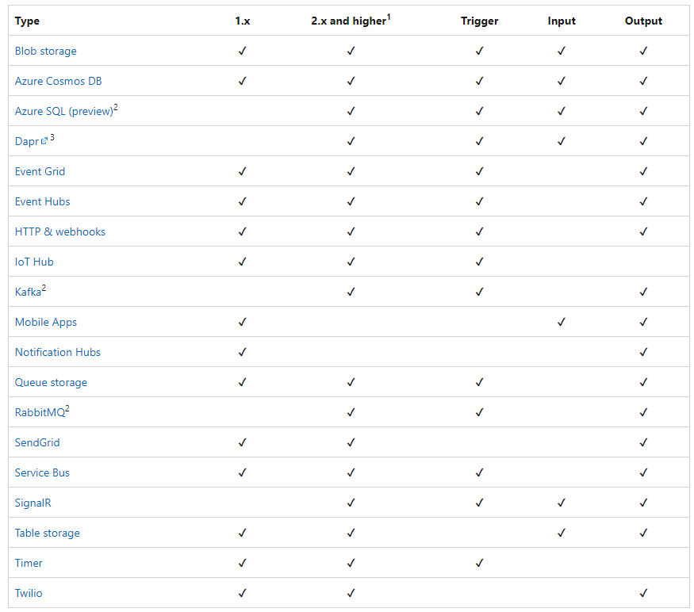

Slide 26
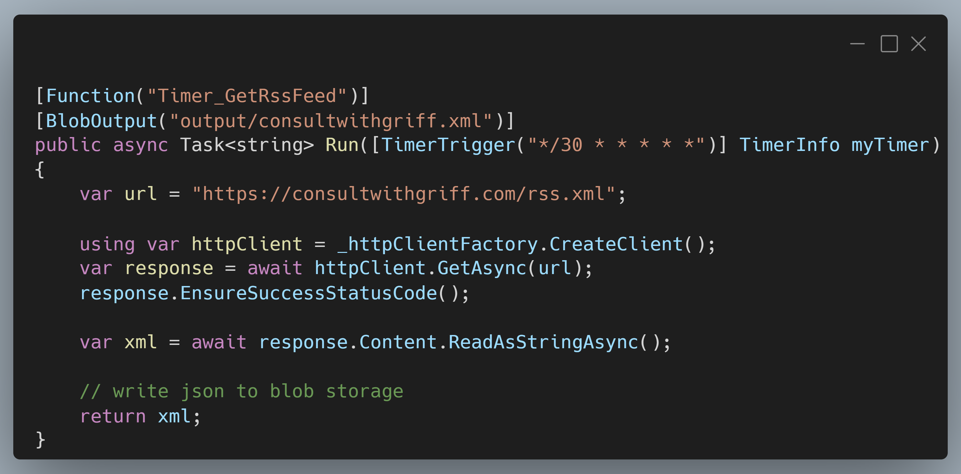

Slide 27
Azure Functions
Write in the language of your choice
C# / F#
JavaScript / TypeScript
Python
Powershell
Java

Slide 28
Azure Functions
Consumption-based pricing*
Scales automatically based off your rules or your workload

Slide 29
Designing Workflows

Slide 30
HttpTrigger
Function
Function
Function
Queue
Function
Producer / Consumer
Pattern
Function

Slide 31
Benefits to this approach

Slide 32
First: Extreme speed…

Slide 33
Second: Automatic retries and poison queues

Slide 34
Let’s do a demo!

Slide 35
There are drawbacks to this approach though…

Slide 36
First: how do you do workflows?

Slide 37
Function
Function
HttpTrigger
Function
Function
Function
Function
Function
Queue
Function
Queue
Function

Slide 38
That’s not the best…

Slide 39
Durable Functions

Slide 40
Durable Functions
Allows for “stateful” functions
Orchestrators managing state – allowing for checkpoints and restarts if necessary!

Slide 41
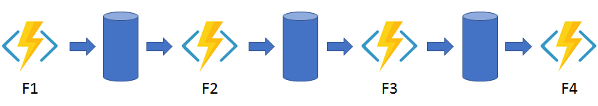
Durable Functions: Chaining

Slide 42
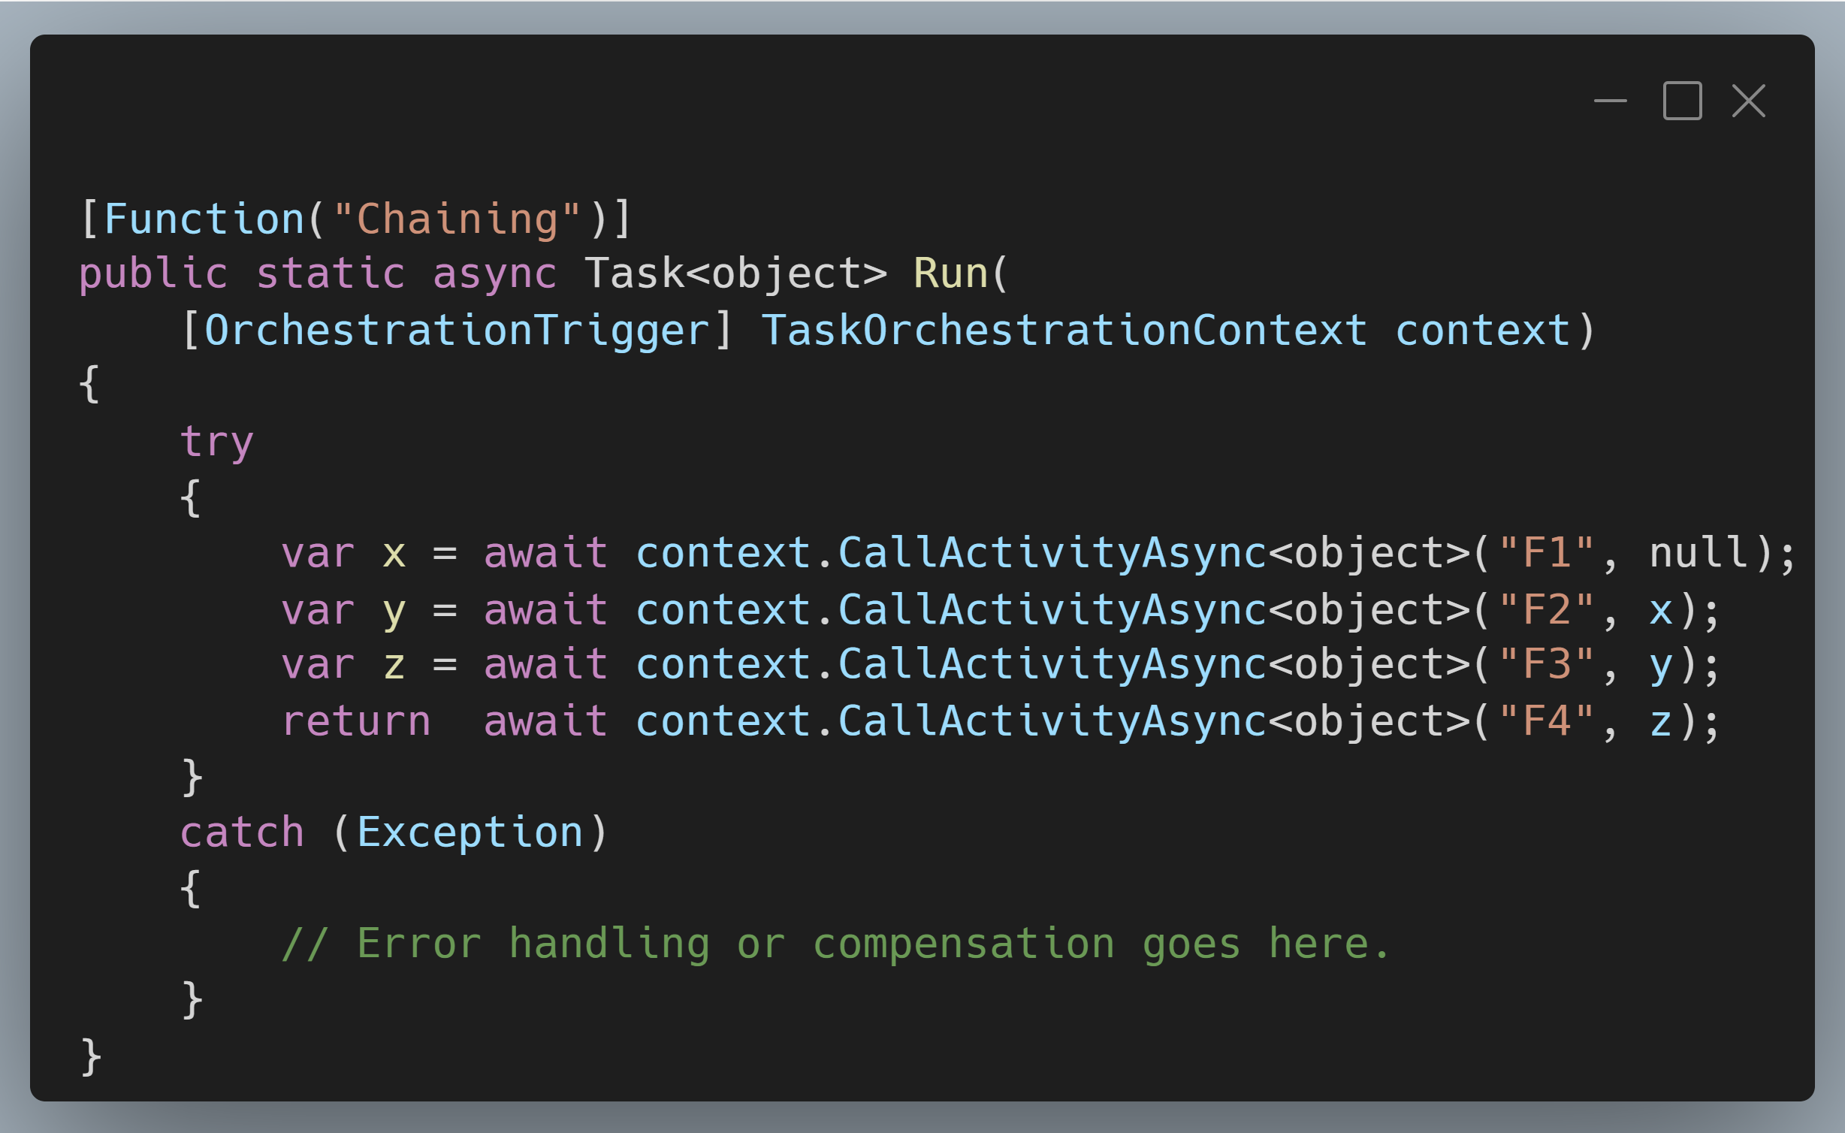
Durable Functions: Chaining

Slide 43
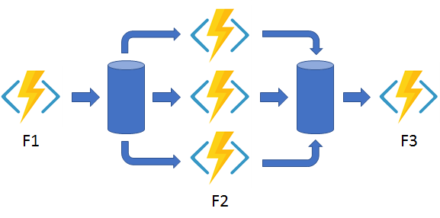
Durable Functions: Fan In/Out

Slide 44
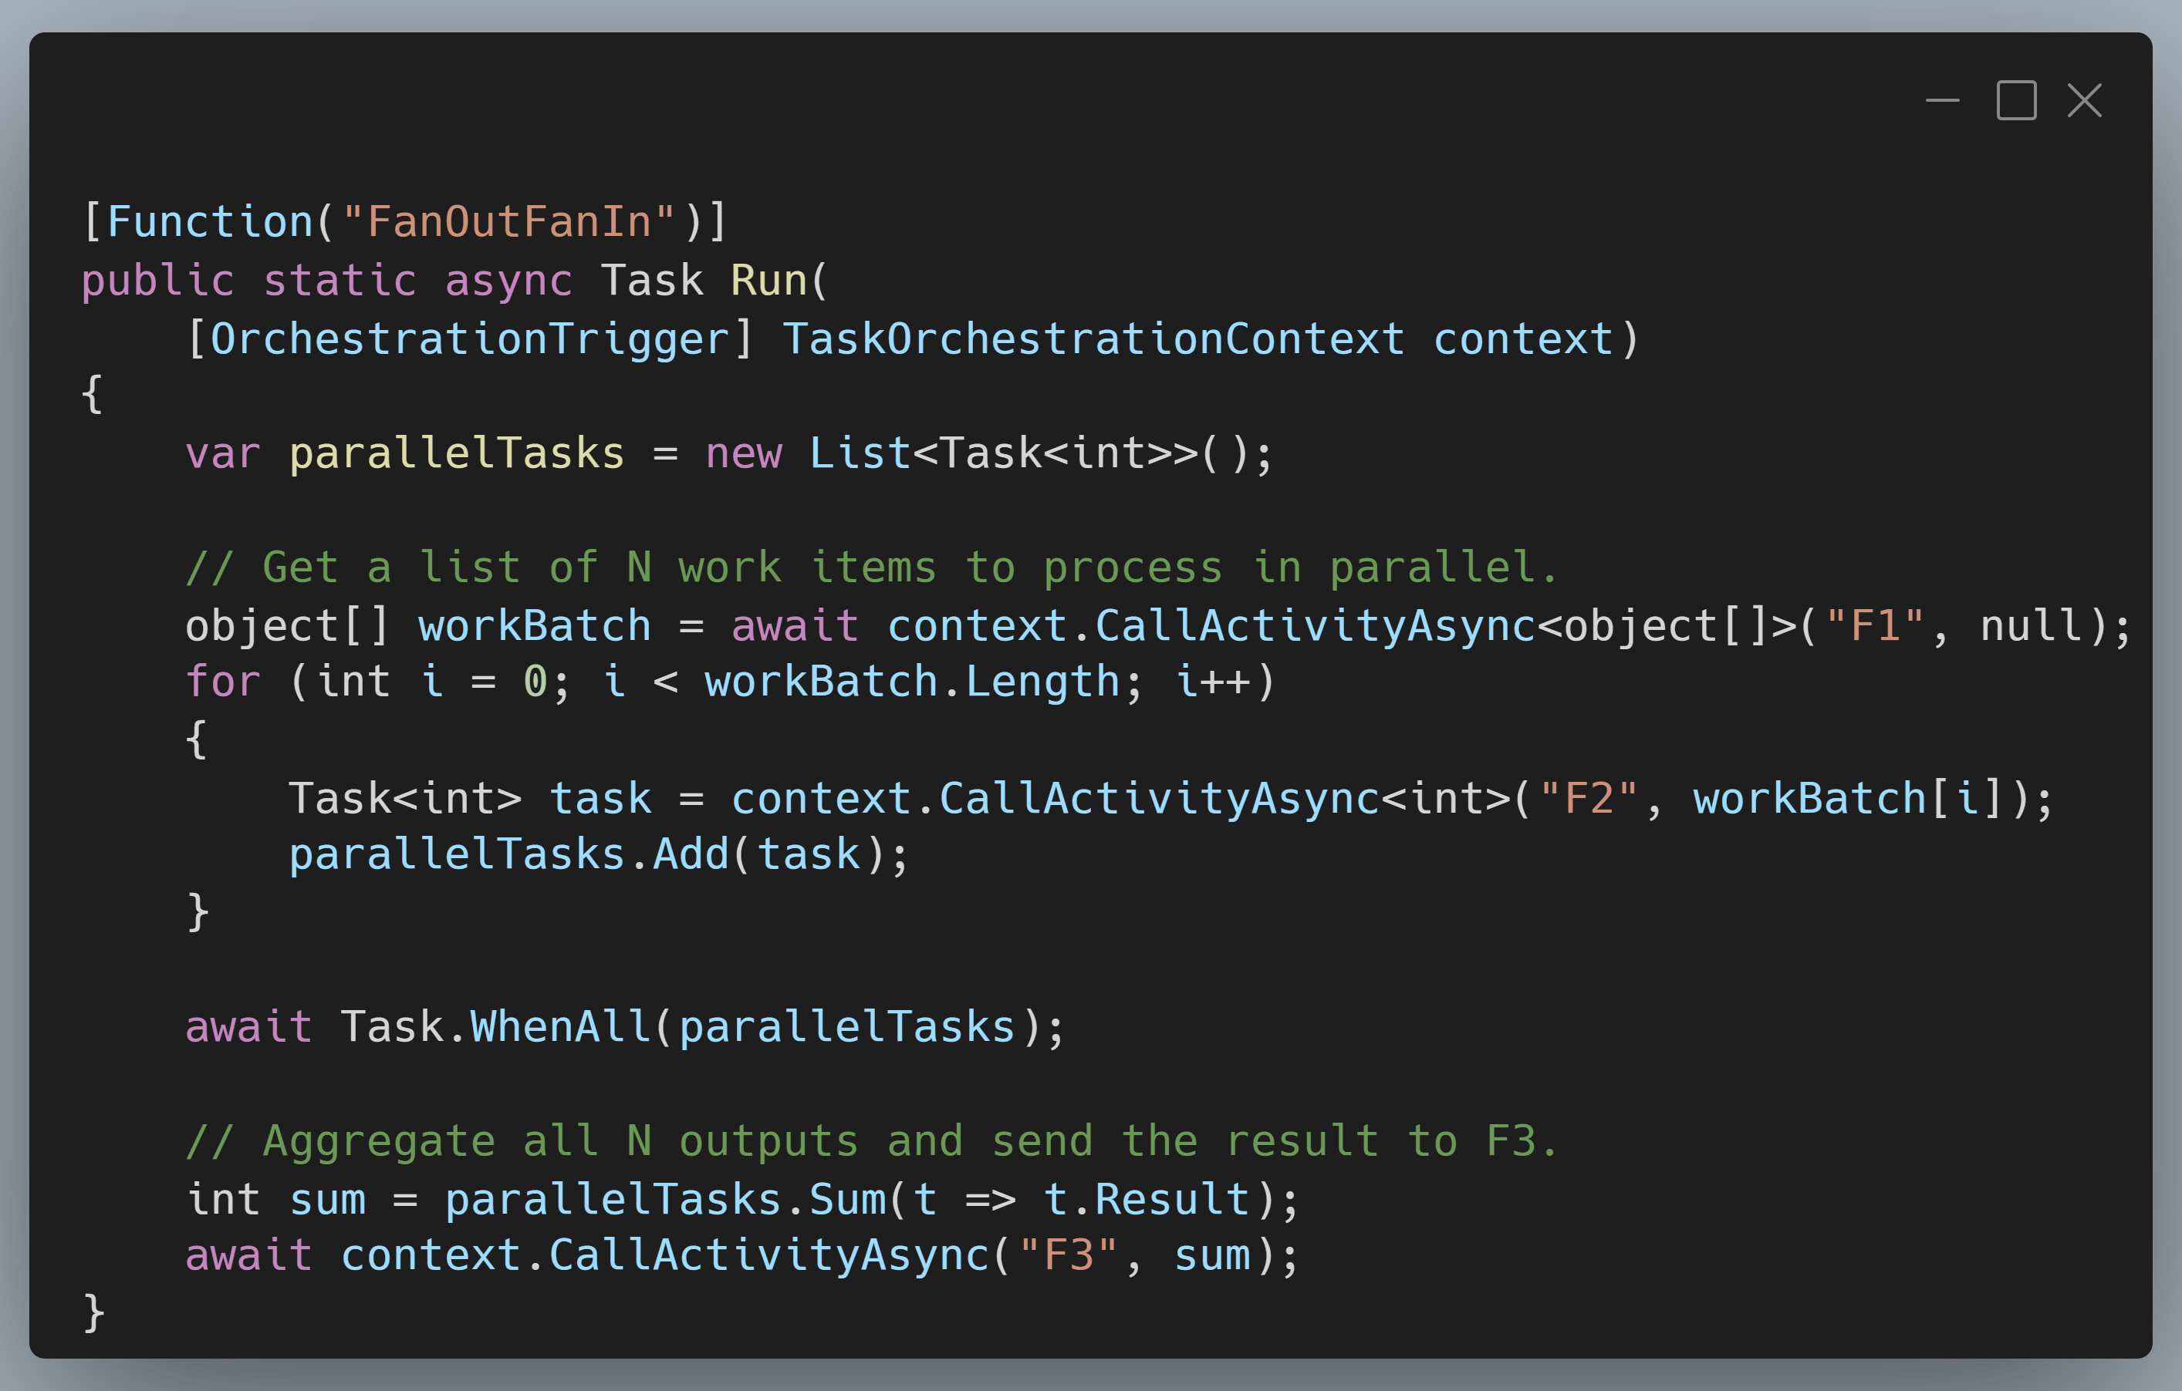
Durable Functions: Fan In/Out

Slide 45
Conclusions
Notes:
Important to abstract out background tasks from your UI or front facing work

Slide 46
Thanks!

